Slide 1

Mastering Asynchronous JavaScript: Callbacks and Promises
Welcome to this exploration of asynchronous JavaScript, where we'll unravel the complexities of callbacks and promises, empowering you to write clean, efficient code.

Slide 2
Why Callbacks and Promises?
JavaScript's Asynchronous Nature
Sequencing and Error Handling
JavaScript is a dynamic language designed to handle asynchronous operations like fetching data from a server. These operations can take time, leading to delays in execution.
Callbacks and promises offer mechanisms to manage the order of operations and ensure proper error handling in asynchronous JavaScript.

Slide 3

The Callback Function
1
Function Passed as Argument
2
Sequencing and Execution
A callback function is a function provided as an argument to another function, to be executed after the original function completes its task.
Callbacks allow you to control the flow of your code, ensuring that certain operations happen in a specific order and only after certain conditions are met.

Slide 4

Illustrating Callbacks in Action
function fetchData(callback) {
setTimeout(() => {
console.log("Data fetched from server");
callback();
}, 2000);
}
function processData() {
console.log("Processing the data...");
}
fetchData(processData);

Slide 5


The Pitfalls of Callback Hell
Deeply Nested Callbacks
1
Excessive nesting of callbacks can make your code difficult to read and manage.
Error Handling Challenges
2
Managing errors within deeply nested callbacks becomes increasingly complex and prone to issues.

Slide 6
Callback Hell Example
setTimeout(() => {
console.log("Step 1");
setTimeout(() => {
console.log("Step 2");
setTimeout(() => {
console.log("Step 3");
}, 1000);
}, 1000);
}, 1000);

Slide 7
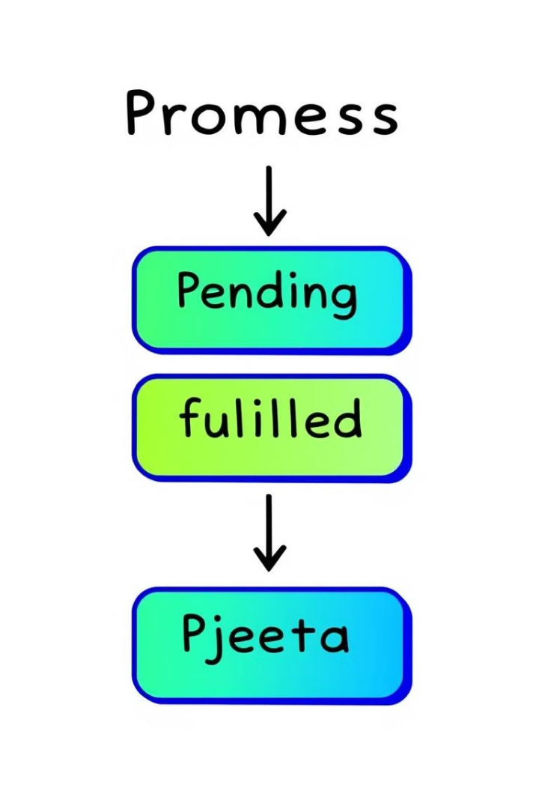


Enter Promises: A Cleaner Approach
Promises Represent Asynchronous Operations
Promise States
Promises have three states: Pending (in progress), Fulfilled (succeeded), and Rejected (failed).
A promise is an object that represents the eventual outcome of an asynchronous operation, which can either succeed or fail.

Slide 8
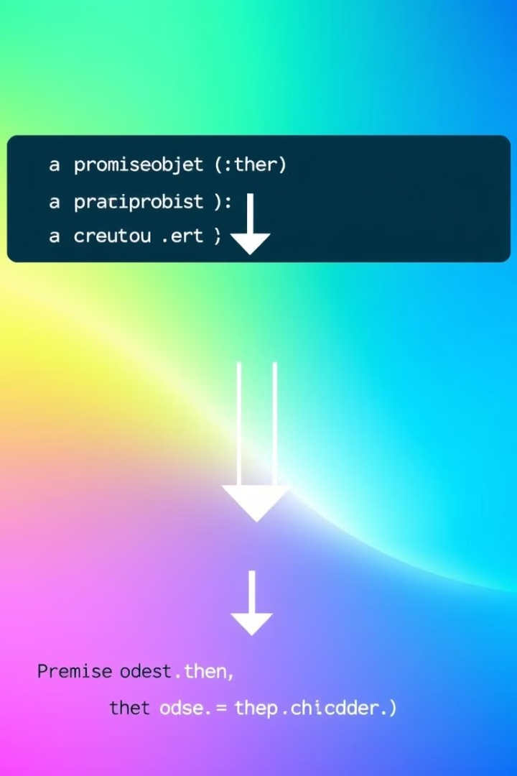
Promises in Practice
const fetchData = new Promise((resolve, reject) => {
setTimeout(() => {
const success = true;
if (success) {
resolve("Data fetched successfully!");
} else {
reject("Error fetching data.");
}
}, 2000);
});
fetchData
.then(data => console.log(data))
.catch(error => console.error(error));

Slide 9
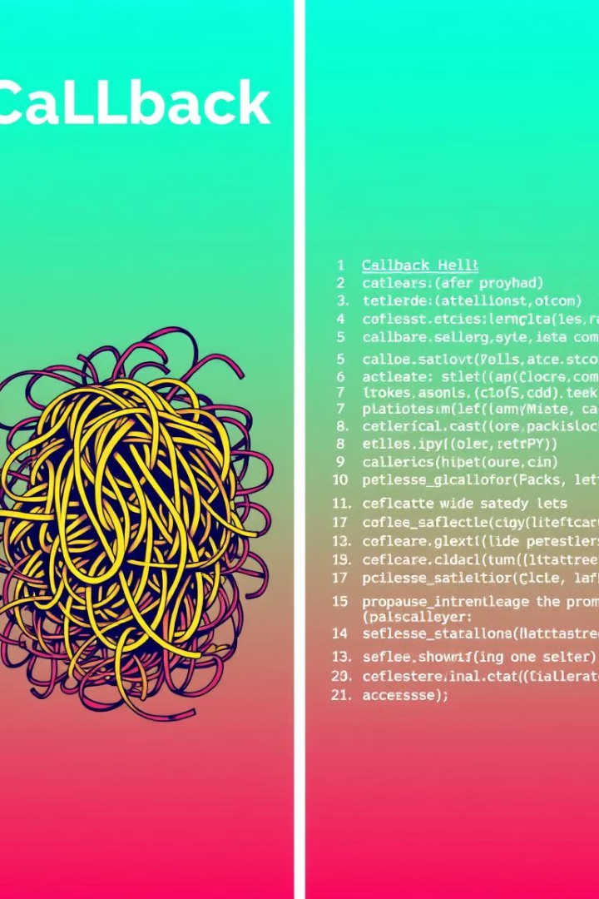
Comparing Callbacks and Promises
Callback
Promise
Leads to Callback Hell
Avoids the issue
Difficult Error Management
Easier error management
Less Readable Code
More organized and readable code

Slide 10
Embrace the Power of Asynchronous JavaScript
Understanding Callbacks and Promises
1
You've gained valuable insights into callbacks and promises, essential tools for managing asynchronous operations in JavaScript.
Promises: The Better Alternative
2
Promises offer a structured and cleaner approach compared to callbacks, simplifying your asynchronous JavaScript development.

